Slide 1


Slide 2
About today…
Arrow Functions
Callback Functions

Slide 3

ARROW FUNCTIONS

Slide 4
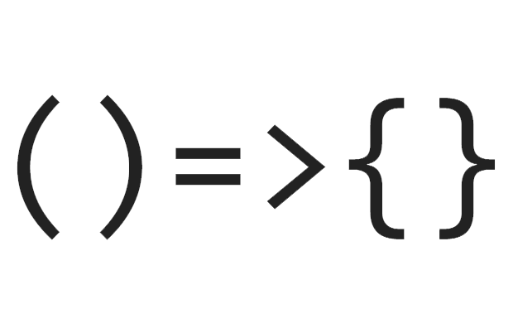
Arrow Functions
Definition
Arrow functions are a concise way to write functions in JavaScript
Syntax
(parameters) => { function body }
Benefits
Shorter syntax
Implicit return for single expressions
Lexical ‘this’ binding

Slide 5
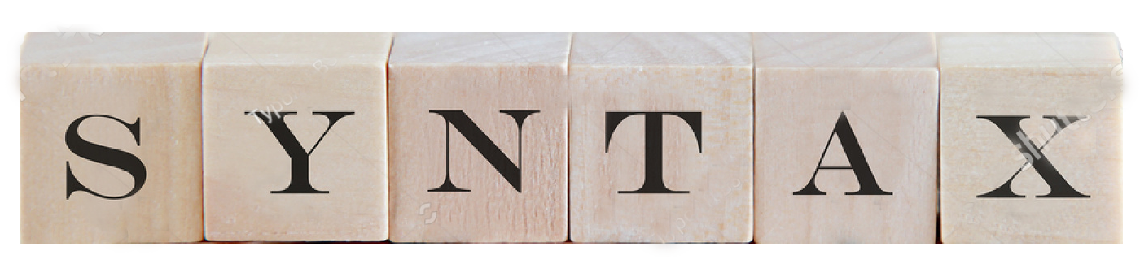
Examples
const square = (x) => x * x;
const greet = (name) => { return "Hello, " + name; };
const sum = (a, b) => a + b;
Implicit return allows omitting the curly braces and return keyword for single expressions

Slide 6
Conversion from traditional to arrow
function add(a, b)
{
return a + b;
}
add = (a, b) => a + b;

Slide 7
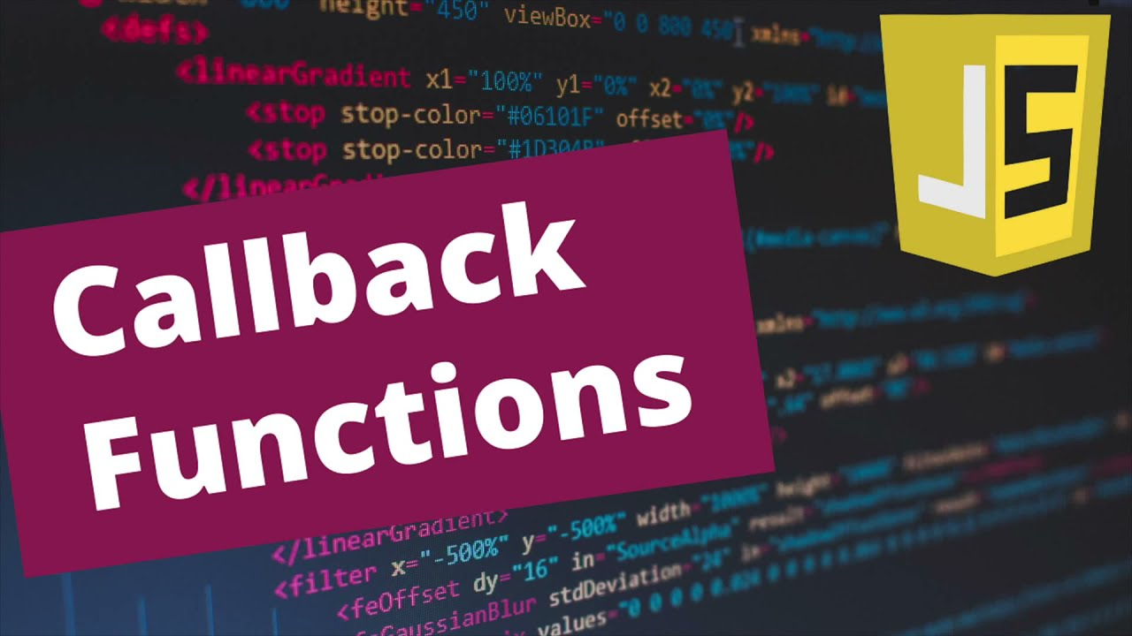

Slide 8
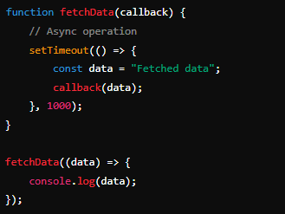
Callback Functions
Definition
Callback functions are functions passed as arguments to other functions to be executed later
Example
Arrow Function as Callback

Slide 9
Benefits of Arrow functions as Callback Functions
Example
Concise syntax makes code more readable
Avoids issues with this binding in nested functions

Slide 10


Slide 11

What is the syntax of an arrow function in JavaScript?
What is the advantage of a arrow function in JavaScript?
What is the purpose of a callback function in JavaScript?

Slide 12

Task 1
Create an arrow function multiplyByTwo that takes a number as input and returns the number multiplied by 2
Task 2
Create a callback function printResult that takes a result as input and logs it to the console

